Slide 1
AI/ML-oriented satellite remote sensing for drought and seasonal impact prediction in agriculture.

Slide 2
Problem statement
Drought and seasonal impact prediction in agriculture
Objectives:
Develop the AI/ML techniques to analyse the satellite images
Identify the specific patterns in the seasonal variations
To predict the occurrence of drought in future
Improve the crop production implementing the anti-drought strategies
RJEs: Remote job entry points

Slide 3
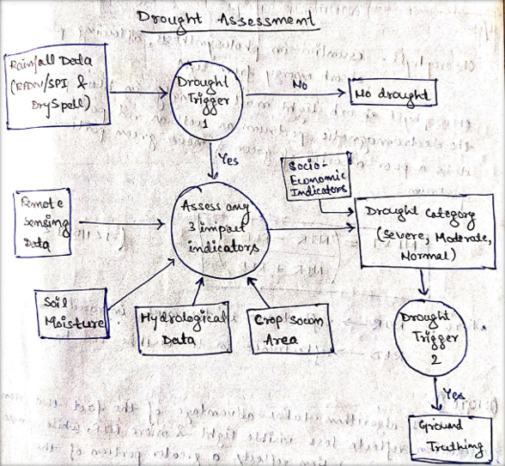
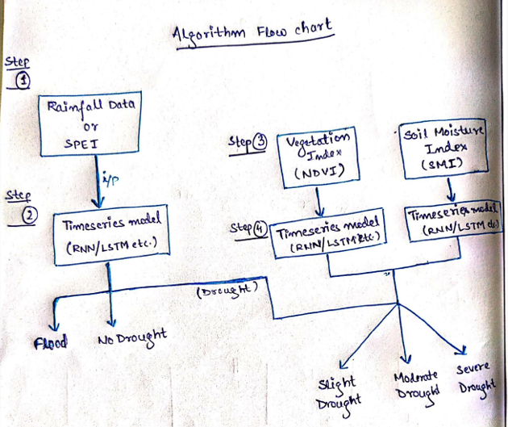
Methodology
(1) General flow diagram for drought assessment

Slide 4
Methodology
Perform the drought prediction for the various district of Karnataka and Maharashtra
Parameters to identify the drought
Normalized Difference Vegetation Index (NDVI)
Standard Precipitation Index (SPI)
Standard Precipitation Evapotranspiration Index (SPEI)
Soil Moisture Index (SMI)
Apply the AI/ML methods to the captured satellite data and compute the above parameters
Predict the occurrence of drought
RJEs: Remote job entry points

